Slide 1

Sheet 2: Search Best First
Eng. Abdulrahman ElMadkhoum

Slide 2
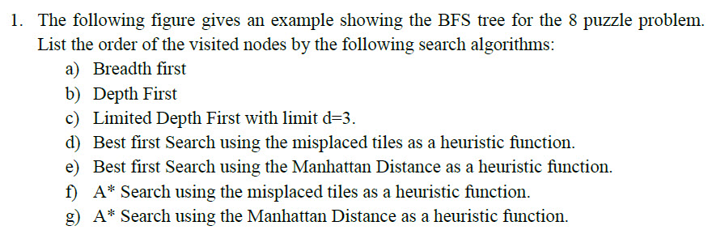
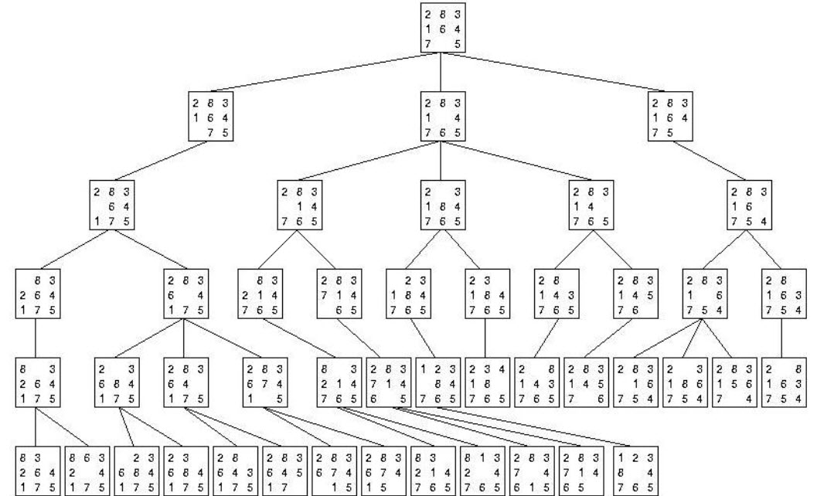

Slide 3
BEST First Search Misplaced Tiles

Slide 4
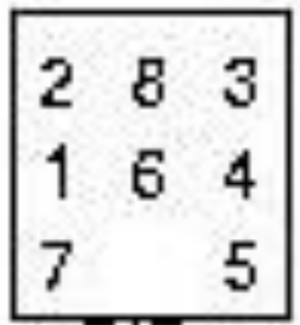
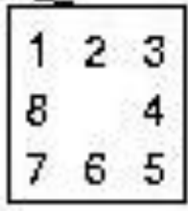
First, Calculate Heuristic using Misplaced Tiles
Initial State
Goal State
1 is misplaced
2 is misplaced
3 is ok
4 is ok
5 is ok
6 is misplaced
7 is ok
8 is misplaced
So, heuristic here = 1+1+1+1 =4
H(n)=4
H(n) = 0

Slide 5
Goal
1+1+1+1 = 4

Slide 6
1+1+1+1 = 4
Goal

Slide 7
Goal
1+1+1+1 = 4

Slide 8
Goal
1+1+1+1 = 4
1+1+1+1+1=5
1+1+1
=3
1+1+1+1+1=5

Slide 9
Goal
1+1+1+1 = 4
1+1+1+1+1=5
1+1+1
=3
1+1+1+1+1=5
1+1+1
=3
1+1+1
=3
1+1+1+1
=4

Slide 10
Goal
1+1+1+1 = 4
1+1+1+1+1=5
1+1+1
=3
1+1+1+1+1=5
1+1+1
=3
1+1+1
=3
1+1+1+1
=4
old
new

Slide 11
Goal
1+1+1+1 = 4
1+1+1+1+1=5
1+1+1
=3
1+1+1+1+1=5
1+1+1
=3
1+1+1
=3
1+1+1+1
=4
1+1+1+1
=4
1+1+1
=3

Slide 12
Goal
1+1+1+1 = 4
1+1+1+1+1=5
1+1+1
=3
1+1+1+1+1=5
1+1+1
=3
1+1+1
=3
1+1+1+1
=4
1+1+1+1
=4
1+1+1
=3
old
new

Slide 13
Goal
1+1+1+1 = 4
1+1+1+1+1=5
1+1+1
=3
1+1+1+1+1=5
1+1+1
=3
1+1+1
=3
1+1+1+1
=4
1+1+1+1
=4
1+1=2
1+1+1
=3
1+1+1+1=4

Slide 14
Goal
1+1+1+1 = 4
1+1+1+1+1=5
1+1+1
=3
1+1+1+1+1=5
1+1+1
=3
1+1+1
=3
1+1+1+1
=4
1+1+1+1
=4
1+1=2
1+1+1
=3
1+1+1+1=4
1

Slide 15
Goal
1+1+1+1 = 4
1+1+1+1+1=5
1+1+1
=3
1+1+1+1+1=5
1+1+1
=3
1+1+1
=3
1+1+1+1
=4
1+1+1+1
=4
1+1=2
1+1+1
=3
1+1+1+1=4
1

Slide 16
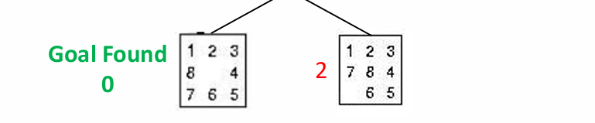
Goal
1+1+1+1 = 4
1+1+1+1+1=5
1+1+1
=3
1+1+1+1+1=5
1+1+1
=3
1+1+1
=3
1+1+1+1
=4
1+1+1+1
=4
1+1=2
1+1+1
=3
1+1+1+1=4
1

Slide 17
Notice that
We choose the node with the least cost from the whole tree and if there are two nodes with the same cost (least cost) we choose the older one
heuristic value express how similar is the current node to the goal
(The goal heuristic value = 0 )

Slide 18
BEST First Search Manhattan Distance

Slide 19
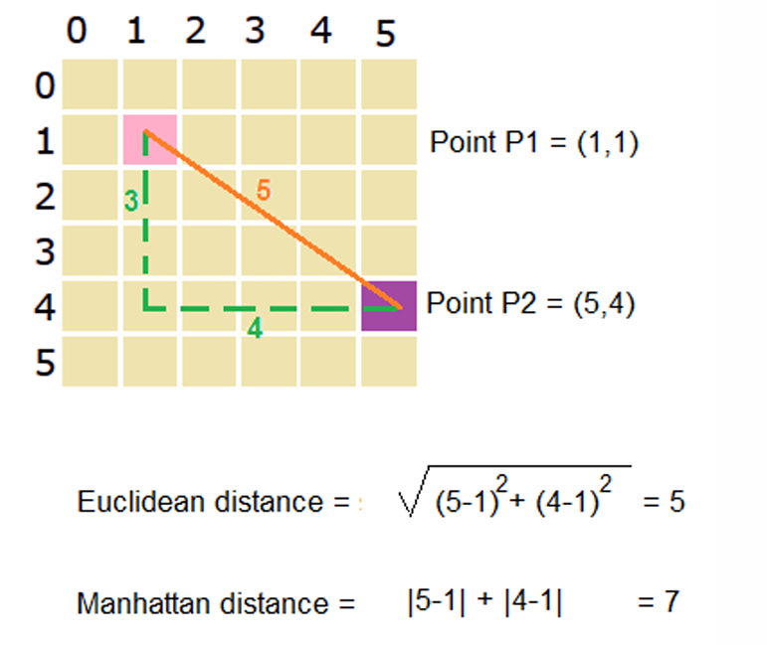
start
Goal

Slide 20
1
2
3
1
2
3
But for this problem for simplification, we calculate how many steps till it be in the write position
We calculate the Manhattan distance for each number
For example (8)
Current coordinates (1,2) and the goal to be at (2,1)
Manhattan distance = |2-1| + |1-2| = 2

Slide 21
First, Calculate Heuristic using Manhattan Distance
Initial State
1 needs 1 movement to be in it’s correct position
2 needs 1 movement to be in it’s correct position
3 is in it’s correct position
4 is in it’s correct position
5 is in it’s correct position
6 needs 1 movement to be in it’s correct position
7 is in it’s correct position
8 needs 2 movements to be in it’s correct position
So, The Heuristics is = 1+1+1+2 = 5
H(n) = 0

Slide 22
Goal
1+1+1+1+2
= 5

Slide 23
Goal
1+1+1+1+2
= 5

Slide 24
Goal
1+1+1+1+2
= 5
1+1+1+1+2
=6
1+1+2
=4
1+1+1+1+2
=6

Slide 25
Goal
1+1+1+1+2
= 5
1+1+1+1+2
=6
1+1+2
=4
1+1+1+1+2
=6
2+1+2
=5
1+1+1
=3
1+1+1+2
=5

Slide 26
Goal
1+1+1+1+2
= 5
1+1+1+1+2
=6
1+1+2
=4
1+1+1+1+2
=6
2+1+2
=5
1+1+1
=3
1+1+1+2
=5

Slide 27
Goal
1+1+1+1+2
= 5
1+1+1+1+2
=6
1+1+2
=4
1+1+1+1+2
=6
2+1+2
=5
1+1+1
=3
1+1+1+2
=5
1+1=2
1+1+1+1=4

Slide 28
Goal
1+1+1+1+2
= 5
1+1+1+1+2
=6
1+1+2
=4
1+1+1+1+2
=6
2+1+2
=5
1+1+1
=3
1+1+1+2
=5
1+1=2
1+1+1+1=4
1

Slide 29
Goal
1+1+1+1+2
= 5
1+1+1+1+2
=6
1+1+2
=4
1+1+1+1+2
=6
2+1+2
=5
1+1+1
=3
1+1+1+2
=5
1+1=2
1+1+1+1=4
1
1

Slide 30
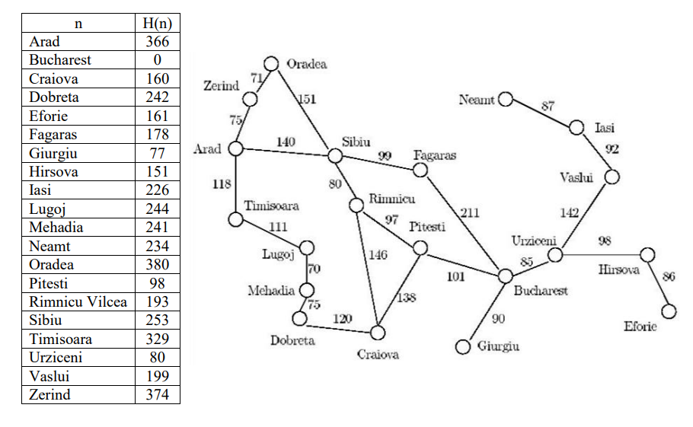
Best First: From Arad/Bucharest

Slide 31
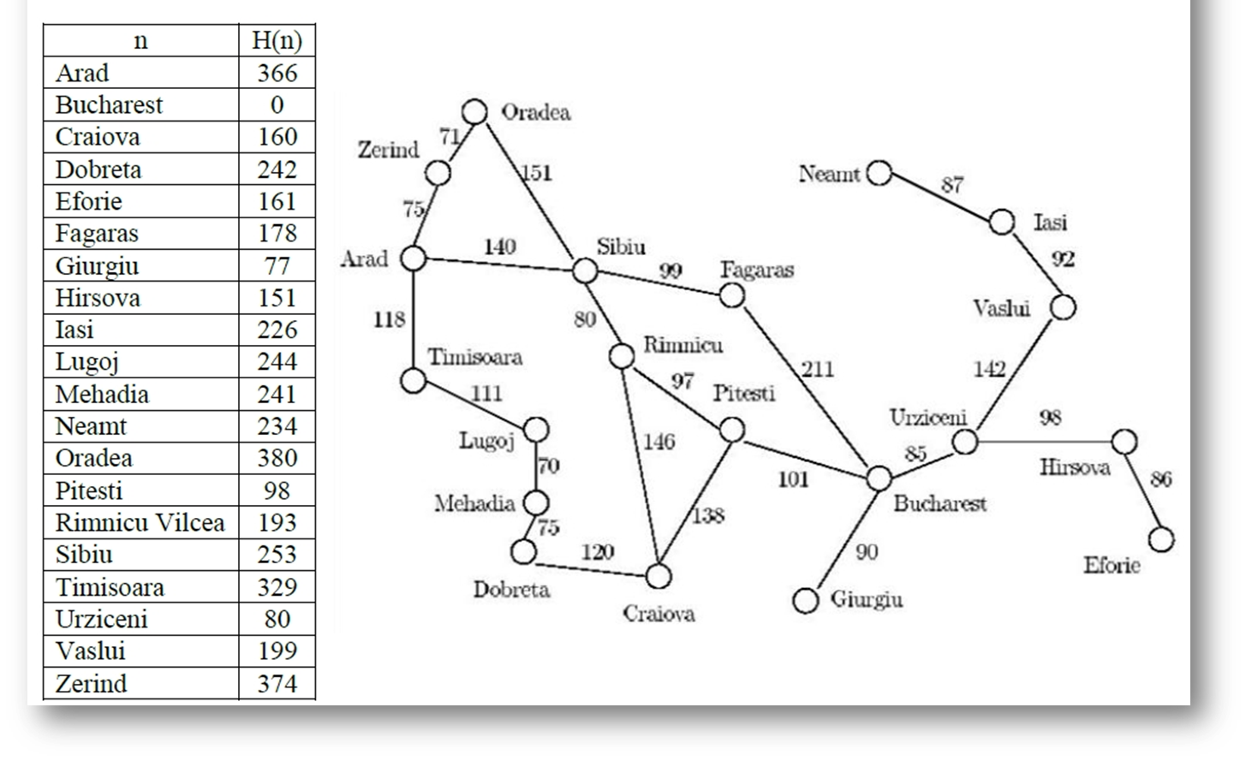
1. Given the Arad/Bucharest route finding problem and the heuristics table below, show the list n of visited nodes using the following search techniques:
Best First
A
253
329
374
S
T
Z

Slide 32
1. Given the Arad/Bucharest route finding problem and the heuristics table below, show the list n of visited nodes using the following search techniques:
Best First
A
253
329
374
S
T
Z
178
380
193
F
O
R

Slide 33
1. Given the Arad/Bucharest route finding problem and the heuristics table below, show the list n of visited nodes using the following search techniques:
Best First
A
253
329
374
S
T
Z
178
380
193
F
O
R
0
B
Order: A,S,F,B
Path: A,S,F,B

Slide 34
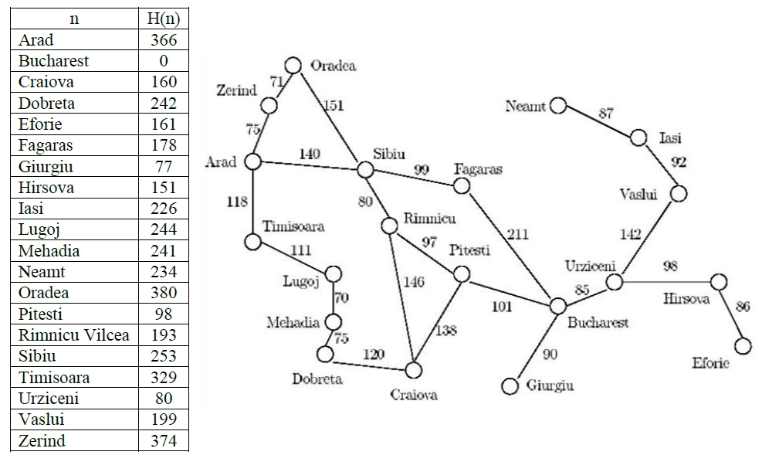
Use Best first
Initial: Craiova …. Goal: Hirsova
100
0

Slide 35
Order: C,P,B,G,U,H Path : C,P,B,U,H
C
100
242
98
193
D
P
R
0
100
B
R
193
F
G
U
178
77
80
H
V
0
199

